Slide 1
Properties and Applications of the 2D Fourier Transform
Tolledo, Charmaine S.

Slide 2

OVERVIEW OF THE ACTIVITY
The Fourier Transform is a mathematical method that permits the investigation and comprehension of a signal's frequency characteristics. It is often used in image processing to transform images from the spatial domain to the frequency domain. [1] To calculate the Fourier transform (FT) of a two-dimensional signal f(x,y), we use the formula, where fx and fy are the spatial frequencies along the x and y axes, respectively. [2]
In this activity, however, we don't have to limit ourselves to this specific integral or function, and we are free to investigate the simulations themselves. Let's look into the widespread application of the Fourier Transform (FT) in image processing!

Slide 3
OBJECTIVES
Use the superposition of sinusoidal waves to generate diverse weaving patterns.
Explore and demonstrate the Convolution Theorem's properties specifically in relation to circles and squares.
Enhance various image models, including canvas weave painting, fingerprint ridges, and images with distinct lines, using automated image masking in the Fourier Domain.

Slide 4
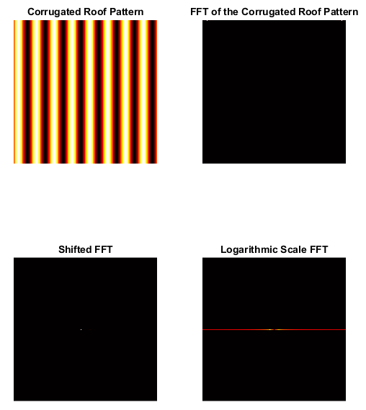
3.1 ROTATION PROPERTY OF THE FT
The figures on the left is the FFT of an unrotated corrugated roof (2D sinusoid). Here, we observe that, in the shifted FFT image, we can see a central peak that represents the dominant frequency component of the pattern. Meanwhile, in the logarithmic scale FFT, we can see an evenly spaced dots along the horizontal axis, indicating distinct frequency components. This indicates that the pattern contains repetitive structures at specific frequencies.
FFT of an unrotated corrugated roof (2D sinusoid)

Slide 5
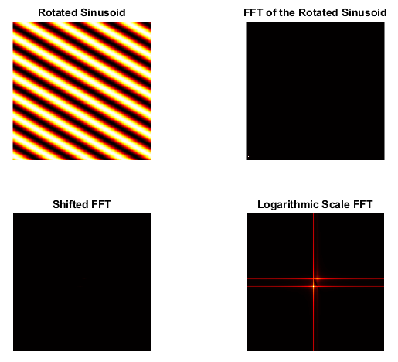
FFT of a 30 ° rotated corrugated roof (2D sinusoid)
Here, The sinusoidal wave is rotated by 30 degrees from the vertical axis. Examining the resulting FFT images, we see that The FFT of the rotated sinusoid is also rotated by 30 degrees along the vertical axis. This alignment can be attributed to the conservation of the rotation property in the Fourier Domain.

Slide 6
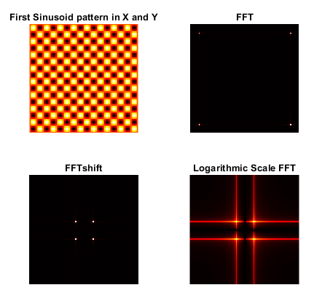
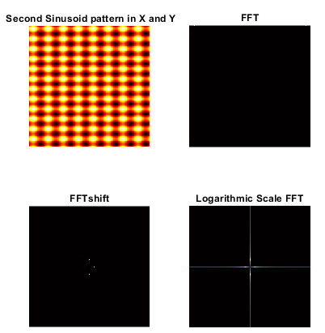
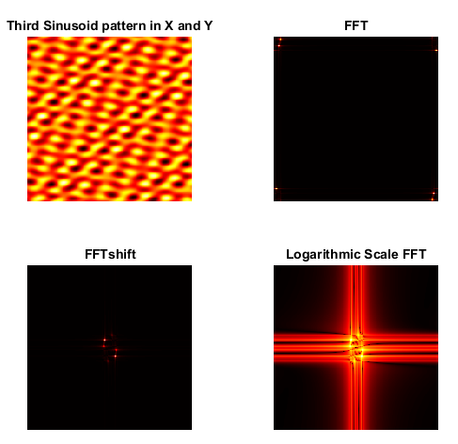
FFT of combinations of sinusoids in X and Y
Here, we explore different combinations of sinusoids to create patterns. The first and second patterns are the result of combining two sinusoidal waves in the X and Y directions of the same frequency. And as we can see, the FFT of these patterns exhibits four dots aligned with the orientation of the original superposition. This aligns with our expectation of four points in the FFT representing the distinct sinusoidal components. Meanwhile, the third pattern s a combination of several rotated sinusoids with different frequencies. As the sinusoids become more chaotic and varied, we observe a weaving pattern in the normal space. In the Fourier space, we observe symmetric points aligned with the rotation of the sinusoids.

Slide 7
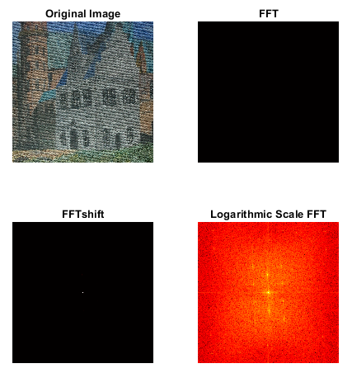
3.2 APPLICATION: CANVAS WEAVE MODELING
AND REMOVAL
In this section, we aim to use the Fast Fourier Transform (FFT) to remove the texture of the canvas from an image, enabling a more focused analysis of the brush strokes. After converting the original image into its grayscale image, we calculated the mean grayscale value of the image and subtracted it from the original image. This removed the DC bias of intensity images.
Then, we applied the FFT.

Slide 8
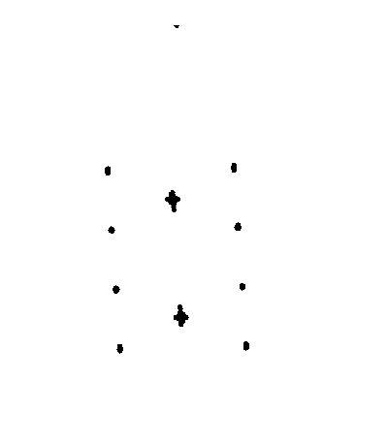
Mask of Canvas Painting
Now, this is the tedious part. To create the filter mask, we identify the maximum values in the FT spectrum and select the corresponding rows and columns above a certain threshold. We then iterate through these selected points, excluding a specific region of the image corresponding to the canvas edges. For each point, we create a circular region around it and retain the pixel values within that region. To obtain the final mask, we convert the accumulated pixel values to grayscale and perform an image complement operation.

Slide 9
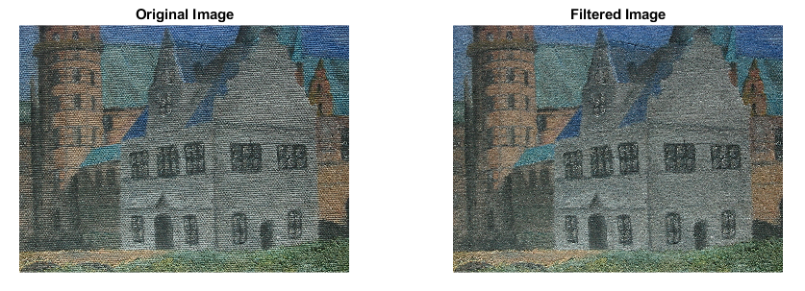
Filtered Canvas Painting
Now, this is the enhanced image which showcases the underlying brush strokes more clearly and provides a cleaner and more focused view of the artwork. This is obtained by inverse transforming the modified Fourier Transform back into the spatial domain. For grayscale images, the mask is multiplied with the transformed image directly. In the case of color images, each color channel is transformed separately, and the mask is applied to each channel individually. The resulting color channels are then combined to reconstruct the enhanced image.

Slide 10
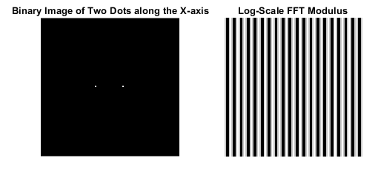
3.3 CONVOLUTION THEOREM REDUX
Here, we study the Convolution Theorem by analyzing the FFT of a binary image containing two dots along the x-axis. The FFT of the image is obtained by applying the Fourier Transform and then shifting the result. Looking at the log shifted FFT, we can see that the FFT of one-pixel circles, represented by the dots, is equivalent to the previously discussed corrugated roof pattern. This resemblance is expected given that the FFT of the corrugated roof also demonstrates symmetric circles. In addition, we observe that the distance between each pair of circles in the FFT corresponds to the line density of the original image. As the frequency of the corrugated pattern increases, the distance between the dots in the FFT also increases, indicating a lower dot frequency.

Slide 11
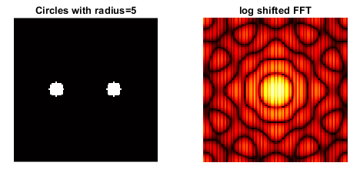
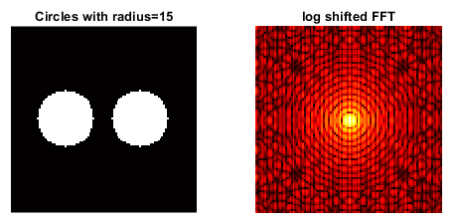
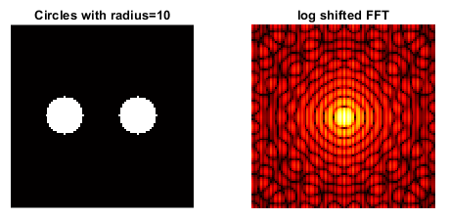
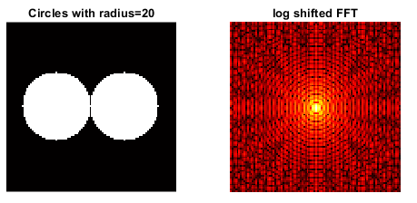
FFT of circles with varying radii
Now, I replaced the dots in the binary image with circles of varying radii and examined their log-scale FT modulus. As the radius increases beyond 0.5, an interesting transformation occurs in the FFT. The resulting pattern starts resembling a laser diffraction pattern, reminiscent of the FFT of a single hole. However, we can still observe vertical lines in the background, representing the FFT of the two dots from the previous slide. Essentially, what we see is a combination of the FFTs of the two dots and the laser diffraction pattern. This demonstrates how different frequency components interact and contribute to the overall FFT pattern.

Slide 12
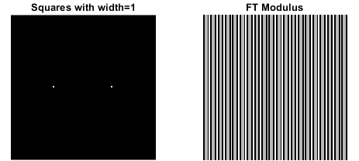
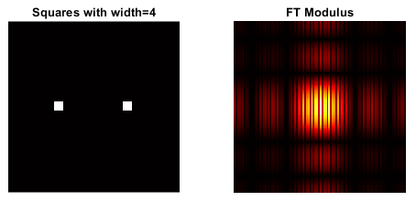
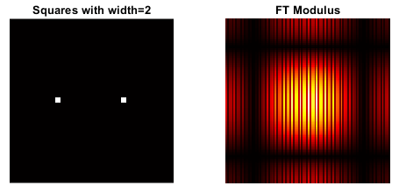

FFT of squares with varying widths
Here, we changed the dots in the binary image with squares of various widths and looked at their FT modulus. Notably, the FFT patterns made by squares with a width of 1 pixel looked like those made by symmetric circle pairs. This is because, on such a small scale, the shapes of the polygons don't matter much, and they can be treated as if they were just a bunch of dots. In the Fourier Domain, there is no change in the relationship between the number of dots per length of a square and the number of lines per length. This is the same as the relationship between pairs of one-pixel circles. But when the width of the squares got bigger than 1 pixel, interesting things happened to the FFT. he resulting patterns exhibited characteristics akin to single-slit interference patterns, albeit with square-shaped slits. Remarkably, the background of the FFT displayed distinct high-frequency lines, corresponding to the FFT of two symmetric dots. Thus, the observed FFT patterns were a combination of the FFTs of the dot pairs and the single-slit interference pattern.

Slide 13
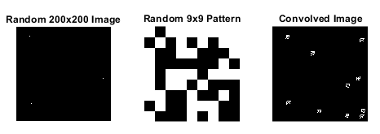
Convolution Theorem Redux
Here, we worked with a 200x200 array called A, initially filled with zeros. To approximate Dirac deltas, we randomly assigned 10 ones at different locations within A. Next, we introduced a 9x9 arbitrary pattern named d. By convolving A and d, we blended the two images together. This convolution operation acts as a merging mechanism, effectively replacing the original dots in A with the characteristics of the random pattern.

Slide 14
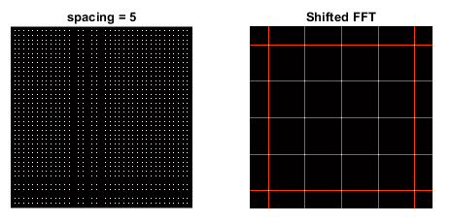
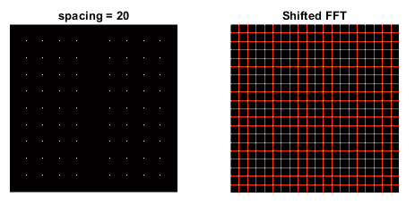
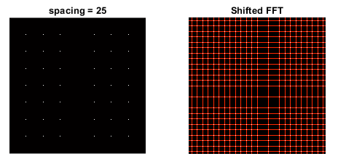
FFT of equally spaced dots with varying frequency
We constructed a 200x200 array filled with zeros and placed equally spaced 1's along the x- and y-axis. The resulting FFT exhibited a grid-like structure, where the spacing of the grid was inversely proportional to the spacing of the dots in the original image. This behavior aligns with the fundamental principles of Fourier analysis, where taking the FFT of a spatial domain corresponds to representing the inverse space, which represents frequency. As a result, the high-frequency components in the original image translated to low-frequency intersections in the FFT.

Slide 15
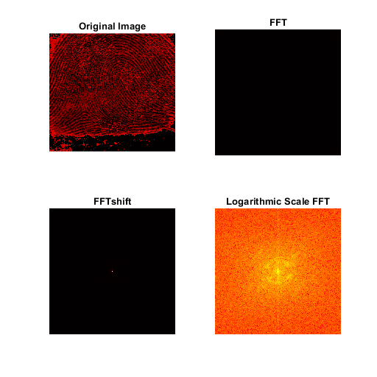
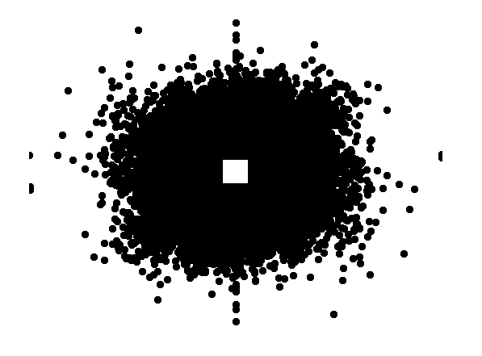
3.4 FINGERPRINTS: RIDGE ENHANCEMENT
Here, we begin by opening a grayscale fingerprint image and mean-centering its gray values. By subtracting the mean grayscale value from the image, we enhance the contrast of the ridges relative to the background. Next, we compute the Fourier Transform (FT) of the mean-centered grayscale image to examine the frequency characteristics of the fingerprint ridges. To further refine the ridge enhancement, a filtering operation is applied to the FT spectrum. Pixels with intensities above a certain percentage of the peak intensity are selected. These selected pixels correspond to the dominant frequency components associated with the ridges. (This is the same code we used in 3.2)

Slide 16
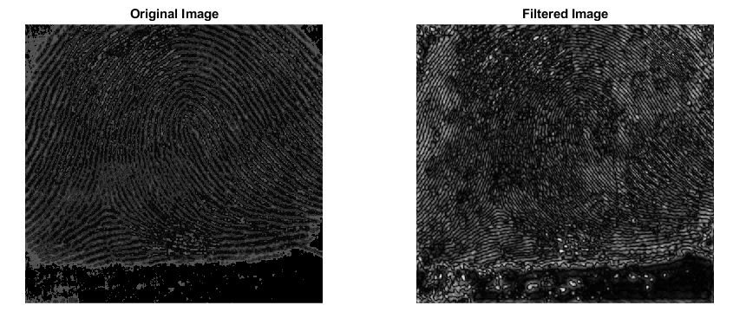
Filtered Fingerprint Ridges
Just like in 3.2 Canvas Painting enhancement, the enhanced image of the fingerprint is obtained through a filtering process using the computed mask. The fingerprint image is first converted to double precision. The mask, which was previously generated, is resized to match the size of the fingerprint image and then shifted in the frequency domain using the FFT shift operation. Then, e FFT of the fingerprint image is multiplied element-wise with the shifted mask. The resulting filtered image, which represents the enhanced fingerprint ridges, provides improved visibility and clarity of the ridge patterns.

Slide 17
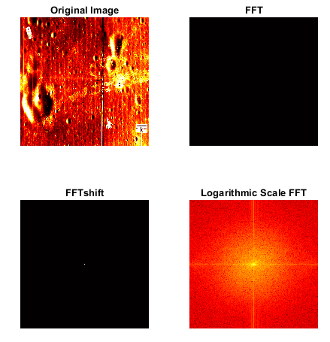
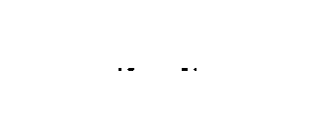
3.5 LUNAR LANDING SCANNED PICTURES: LINE REMOVAL
A similar approach to the code used in canvas painting enhancement and fingerprint ridge enhancement can be applied for line removal. The presence of unwanted vertical lines in the original image is treated as a corrugated roof with specific frequency components in the Fourier Transform domain. To address this, a mask is created by incorporating dots or circles along the horizontal axis. By applying this mask, the frequencies associated with the unwanted lines are targeted and filtered out, resulting in an enhanced image with significantly reduced or eliminated lines.

Slide 18
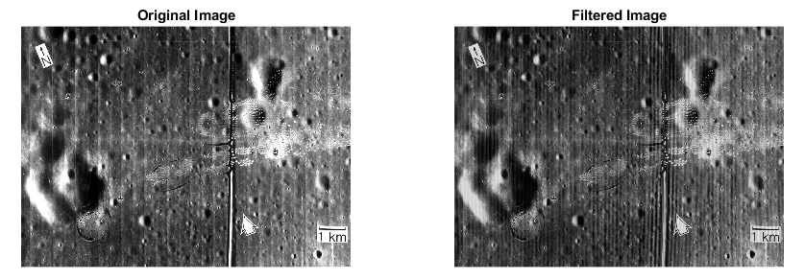
Filtered Lunar Landing Scanned Picture
Now, we can see that the filtered image shows that the vertical lines that were in the original image were greatly reduced or gone. By using the mask made to target the frequency components of these unwanted lines, the improved picture shows the moon landing scene in a way that is cleaner and more pleasing to the eye.

Slide 19
REFLECTION
This is the longest report and coding task I have worked on so far, and embarrassing as it may sound, had been avoiding it because I doubted my ability to complete it. I faced significant challenges during this task, which caused me to struggle and fall behind in class. However, I am grateful to my friend, Mar Princer, for helping me, particularly with the code related to masking. I will definitely credit him for his contribution. Despite the difficulties, I am proud to say that I managed to overcome them and successfully completed the task. Therefore, I would give myself a perfect score of 10/10.

Slide 20
REFERENCES
[1]https://byjus.com/maths/fourier-transform/#:~:text=Fourier%20Transform%20is%20a%20mathematical,%2C%20RADAR%2C%20and%20so%20on.
[2] Lab manual
[3] https://www.researchgate.net/figure/Examples-of-different-classes-of-fingerprints-a-right-loop-b-whorl-and-c-arch_fig2_265986190
[4] https://www.lpi.usra.edu/publications/slidesets/apollolanding/ApolloLanding/slide_05.html

Slide 21
End

